Slide 1

Product Analyzer:
Automated Sentiment Analysis of customer Reviews
Submitted by -
Hitesh
210995

Slide 2
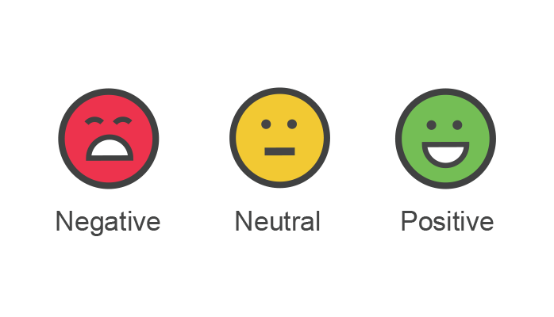
Sentiment Analysis
Whether it's purchasing a new product, selecting a service provider, or a restaurant, people often rely on the opinions and experiences shared by fellow customers, In today's digital landscape, customer reviews have become a vital component in the decision-making process of consumers. As businesses strive to meet the evolving needs and preferences of their target audience, understanding customer feedback has never been more crucial.
This is where sentiment analysis plays a significant role. Sentiment analysis, also known as opinion mining, is a technique used to automatically extract and analyze the sentiments expressed in customer reviews. It involves utilizing natural language processing and machine learning algorithms to classify opinions as positive, negative, or neutral.

Slide 3

Need for automated sentiment analysis of customer reviews
Manual analysis of customer reviews is a time-consuming and resource-intensive process
Processing and understanding these reviews becomes an arduous task as the volume continues to increase. Businesses simply cannot keep up with the sheer scale of reviews without the aid of automation.
Manual analysis of customer reviews is prone to subjectivity and bias
Businesses that operate across various product categories or have a wide range of offerings face the challenge of scalability and adaptability in manual analysis

Slide 4
Objectives
To save the time invested in reading long texts manually.
To perform the sentiment analysis using different approaches to check the accuracy
To perform feature engineering using heuristic approach
To perform feature engineering using machine learning approach
To apply various classification algorithms and compare accuracy and robustness
To increase accuracy using ensemble machine learning techniques
To automate the sentiment analysis for product analysis based on customer reviews
Deploy the created model.

Slide 5

Methodology
The whole framework of this project is divided into different parts, from initial data collection to the final deployment is discussed below.
The crucial goal of this study is to synthesize and implement the Product Analyzer, which is an automated network for sentiment classification of customer reviews. The aim is to leverage natural language processing and cutting-edge ML techniques to accurately classify customer reviews into their true sentiment, thereby providing valuable insights into the overall sentiment of a product.
The development of the product analyzer tool involved implementing the sentiment analysis model within a user-friendly software interface. The tool was designed to accept customer reviews as input and provide sentiment analysis outputs in real-time. Programming languages such as Python were used for the development, leveraging libraries and frameworks like scikit-learn, NLTK and web scraping tools like BeautifulSoup.

Slide 6
Data
Text Preprocessing
EDA
Feature Engineering
Classification Algorithms / Model Training
Deployment
Model Evaluation
Users

Slide 7
Heuristic Approach

Slide 8

Heuristic Approach
A heuristic approach is a problem-solving method that involves using practical, intuitive, and rule-of-thumb strategies to find solutions or make decisions. It is a general problem-solving technique that aims to provide efficient solutions without guaranteeing their optimality.
Heuristics are often employed by manually extracting the features using domain knowledge, intuitions and expertise

Slide 9
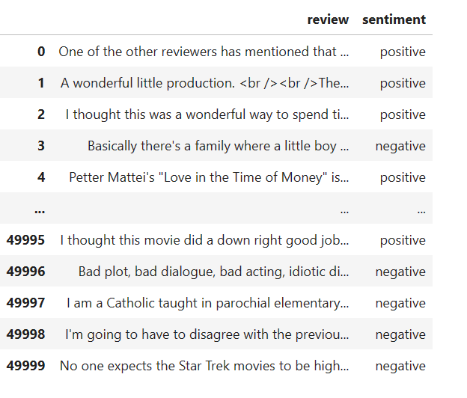
Raw Data

Slide 10
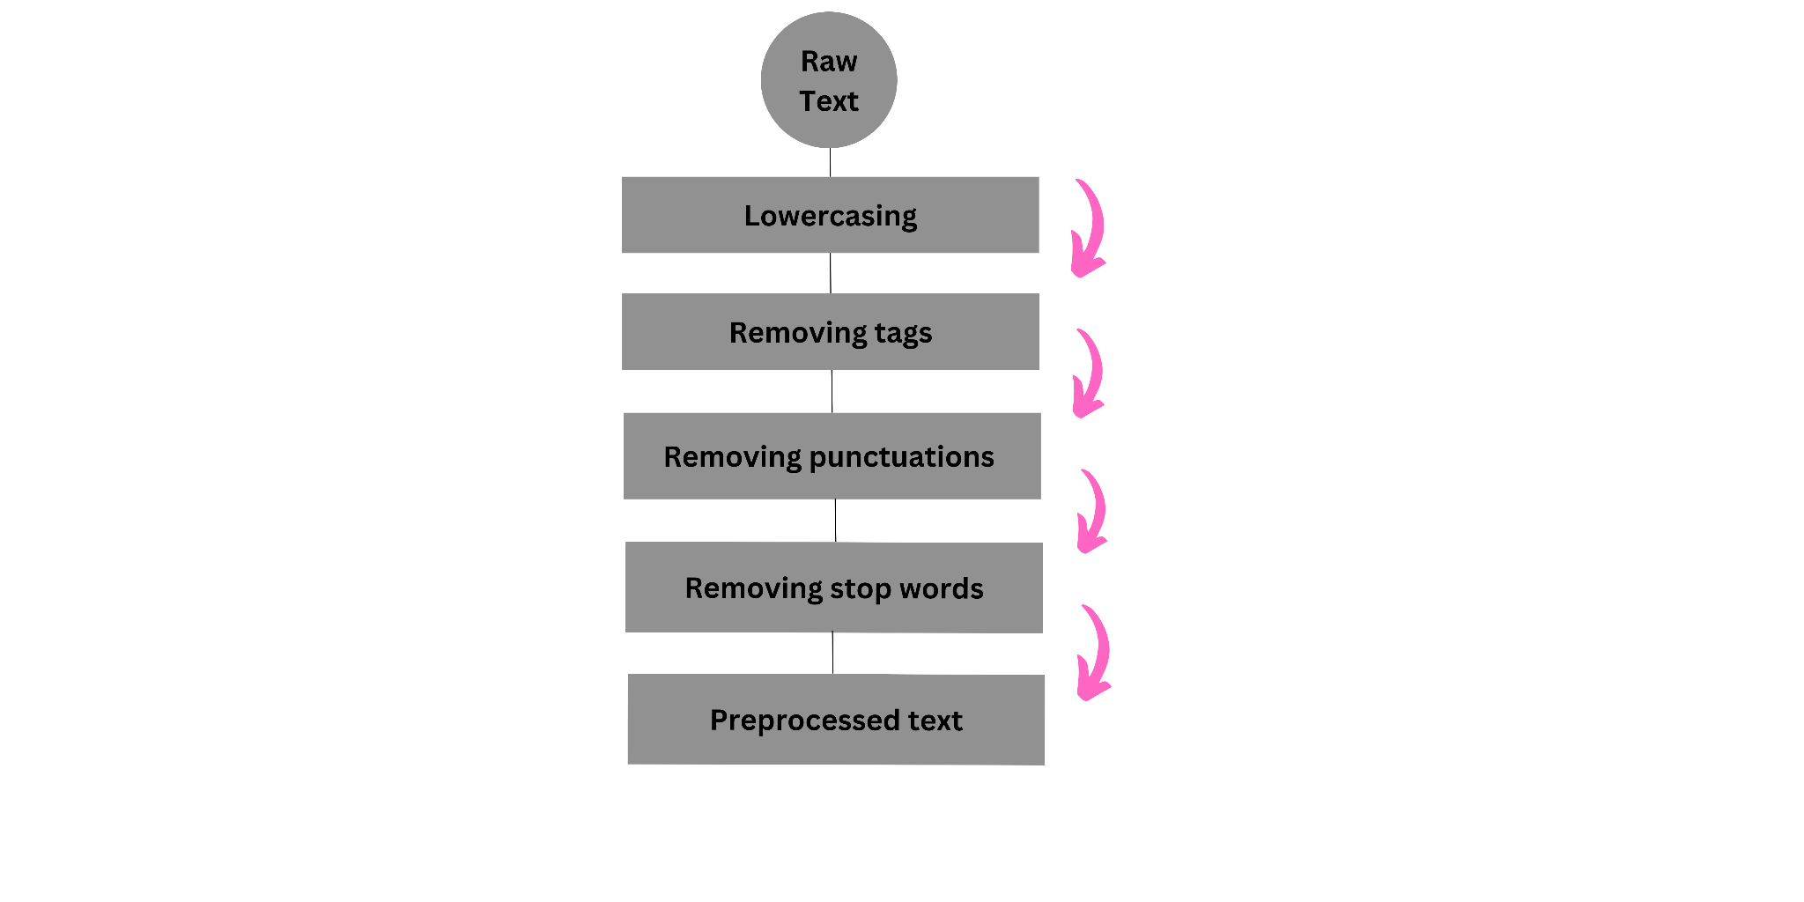
Text Preprocessing

Slide 11
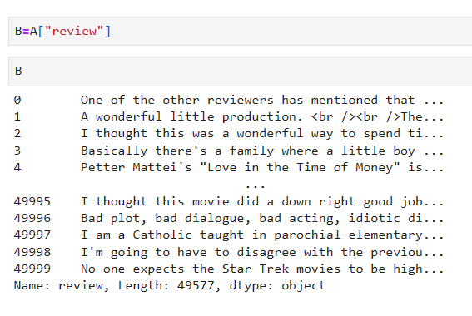
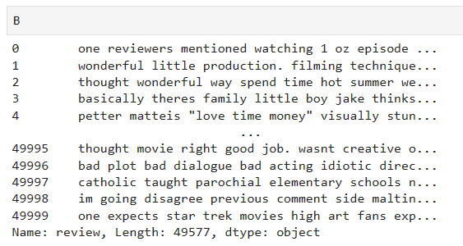
Before Preprocessing
After Preprocessing

Slide 12
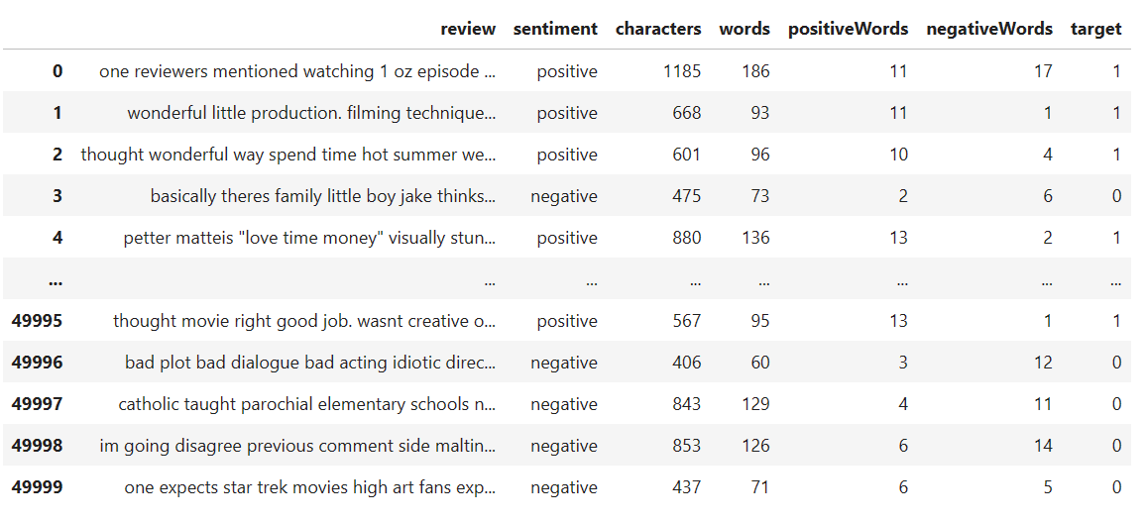
Feature Extraction
Number of Characters in a review
Positive word count
Number of words in a review
Negative word count

Slide 13
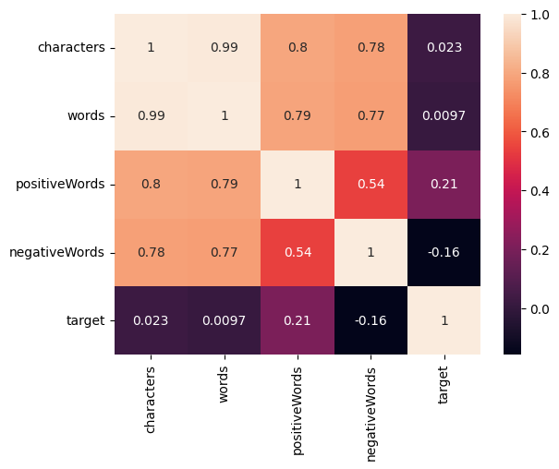
Exploratory Data Analysis
The heatmap clearly shows that all the features are weakly correlated with the target variable.
Out of all the heuristic variables, positive and negative words correlate somewhat with the sentiment. Positive words have a correlation of 0.21 and negative words have a correlation of -0.16.
Strong multicollinearity is detected.

Slide 14
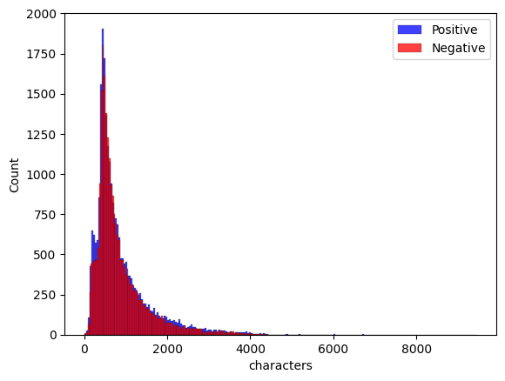
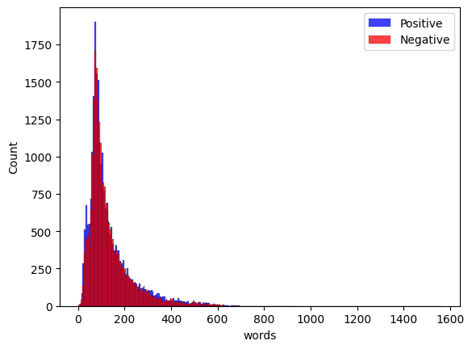
Comparison of Character & Word Count
From the comparison, it is clear that there is not much of a difference in the distribution of the words under the positive and negative sentiment.
From the comparison, it is clear that there is not much of a difference in the distribution of the characters under the positive and negative sentiment.

Slide 15
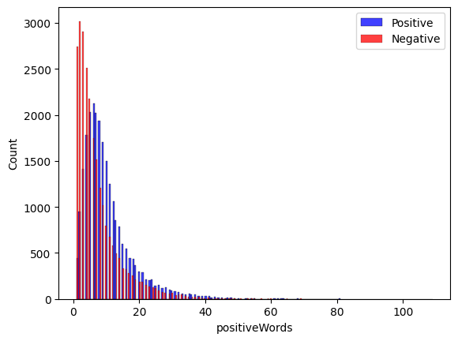
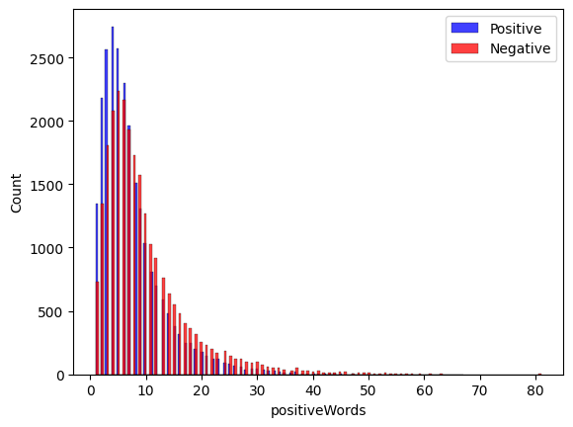
Comparison of Word Polarity
Positive Sentiment
Negative Sentiment
The distribution of the negative words under the negative sentiment is slightly more compared to positive words.
The distribution of the positive words under the positive sentiment is slightly more compared to negative words.

Slide 16
Model Building
The Product Analyzer tool utilizes advanced classification models to automate the process of sentiment analysis. These models are trained on labeled data to classify customer reviews into positive and negative sentiments.
Various classification models were fit and compared them using accuracy and MCC metric of classification.
Classification models used in this analysis are-
i) Logistic Regression
ii) Random Forest Classifier
iii) AdaBoost Classifier
iv) Naive Bayes Classifiers
v) Support Vector Machine
vi) XGBoost Classifier

Slide 17
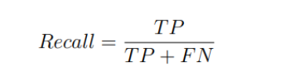
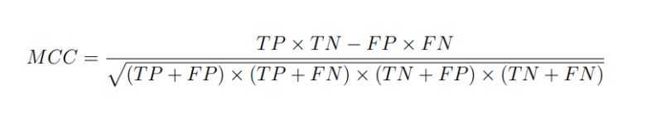
Metrics for Evaluation
Accuracy
Accuracy measures the overall correctness of the model's predictions by calculating the ratio of correctly classified instances to the total number of instances. It provides a general assessment of the model's performance but may not be suitable when the classes are imbalanced.
Recall
It evaluates the capability of the model to correctly identify the prediction of positive labels among the total predictions that are true in the dataset. It checks the proportion of accurate positive predictions made by the model compared to the total number of positive instances. A recall score of 1 indicates that the model successfully recognized every positive case, demonstrating a high ability to capture positive instances.
Accuracy = (No. of correct predictions)/ (Total Predictions)
Matthews correlation coefficient
The Matthews Correlation Coefficient is a valuable metric for assessing the overall performance of binary classifiers and is commonly used in machine learning. It provides a balanced evaluation by considering both the positive and negative class predictions, It considers all four classification outcomes, making it a reliable measure even when the number of instances in each class varies significantly.

Slide 18
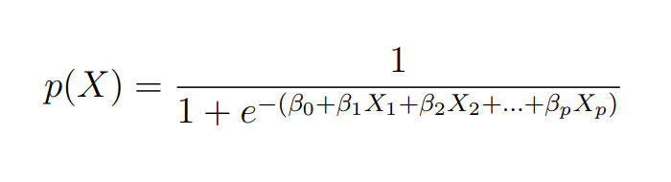
Logistic Regression
Logistic regression is commonly used classification model in sentiment analysis tasks. It is a statistical model that is particularly suitable for binary classification problems, where the goal is to predict one of two classes, such as positive or negative sentiment.
Logistic regression estimates the probability of an instance belonging to a specific class. It uses a logistic or sigmoid function to map the linear combination of input features to a value between 0 and 1. The logistic function ensures that the predicted probabilities are within this range, allowing us to interpret them as the likelihood of an instance belonging to a particular class.

Slide 19
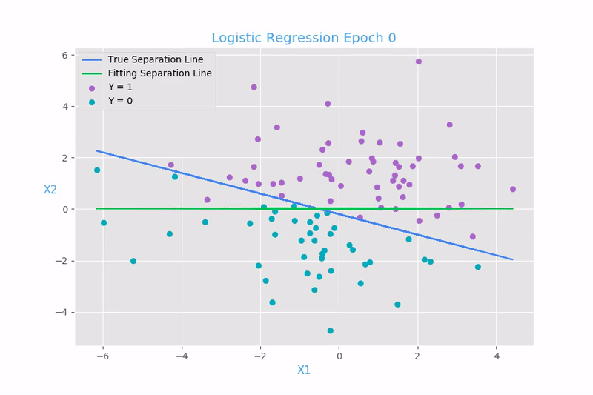
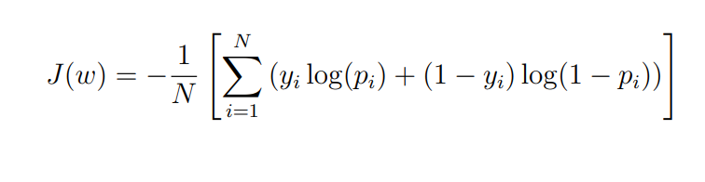
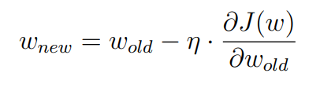
The logistic regression model is trained using a labeled dataset, where the input features are associated with corresponding class labels (e.g., positive or negative sentiment). The training process aims to find the best set of parameters that maximize the likelihood of the observed labels given the input features.
Once the logistic regression model is trained, it defines a decision boundary that separates instances belonging to different classes. In binary classification, this boundary is typically a hyperplane in the feature space.
The logistic regression model learns the weights during the training process to find the best hyperplane that minimizes the difference between predicted probabilities and actual class labels. This hyperplane serves as the decision boundary for making class predictions based on the input feature values.
Weight Updates -
The weights are updated during each iteration using an optimization algorithm called gradient descent. The goal of gradient descent is to minimize the loss function. It mostly uses Cross entropy loss function to update the weights.

Slide 20
1
Y > 0.5
The model predicts the class by comparing the estimated probability calculated using the sigmoid function to a chosen threshold (usually 0.5). If the probability is above the threshold, the instance is classified as belonging to one class; otherwise, it is classified as belonging to the other class.
0.5
Threshold Value
Y < 0.5
X

Slide 21
Random Forest
Random Forest is an ensemble learning method that combines multiple decision trees to make predictions. It leverages the wisdom of the crowd by aggregating the predictions of individual trees to produce a final prediction.It offers accuracy, robustness, and feature importance analysis, making it a powerful tool for various machine learning tasks.
Why Random?
Random Sampling
Random Feature Selection
In random forest a set of decision trees is built using a subset of the training data and random subset of features art each node. Decision tree is nothing but a flow chart like structure which contains various nodes such as
1) Root Node
2) Internal Decision Node
3) Leaf Node
The final prediction of the Random Forest is made by aggregating the predictions of all individual decision trees. For classification tasks, the most common aggregation method is majority voting, where each tree's prediction is considered, and the majority class prediction is taken as the final prediction. For regression tasks, the predictions are averaged across the trees to obtain the final prediction.

Slide 22
(Root Node)
Positive words < 1000
yes
No
Negative words > 1000
(IDN)
Number of words >2000
No
yes
yes
No
Positive
Number of characters >2000
Positive
Negative
No
Yes
(Leaf Nodes)
Positive
Negative

Slide 23

……..
random_state= r1
random_state= r2
random_state= r3
random_state= rn
Y ~ X1,X2
Y ~ X3,X4
Y ~ X5,X8,X10
Y ~ X1,X8,X4,X6,X7
P1
P2
P3
Pn
P
(Final Prediction)

Slide 24
AdaBoost Classifier
Adaptive Boosting Classifier, is a popular ensemble learning method used in machine learning for classification tasks. It is known for its ability to combine multiple weak classifiers to create a strong and accurate classifier.
It operates based on the concept of boosting, which is a sequential process that focuses on instances that were previously misclassified. The algorithm assigns higher weights to these challenging instances, allowing subsequent weak classifiers to pay more attention to them and improve their accuracy.
The misclassifications from the first tree will be passed on to the input of next tree this way second tree will be stronger in the prediction.
Boosting is a sequential process where each subsequent model focuses on instances that the previous models struggled with. Each weak classifier is trained on a modified version of the training data that assigns higher weights to the instances that were misclassified by previous models. This allows subsequent models to focus on the challenging instances and improve the overall performance.
It trains the weak classifiers iteratively. In each iteration, the algorithm adjusts the weights of the training instances based on the previous weak classifiers' performance. It then trains a new weak classifier on the modified training data. This iterative process continues until a specified number of weak classifiers are trained, or a performance criterion is met.

Slide 25
random_state=x1
random_state=x2
random_state=x3
Train
Test
Train
Test
Train
Test
Misclassified weights are passed as training set
Misclassified weights are passed as training set

Slide 26
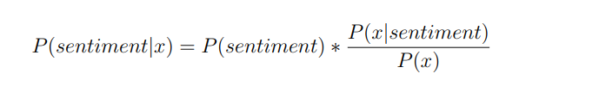
Naive Bayes Classifier
Naive Bayes classifiers are a class of simple yet effective machine learning algorithms used for classification tasks. They are based on the application of Bayes' theorem and assume independence among the input features.
Naive Bayes classifiers apply Bayes' theorem and assume independence among input features to make predictions for classification tasks. Despite their simplicity, they often deliver competitive results, especially in scenarios with limited training data and high-dimensional feature spaces.There are different types of naive Bayes classifiers-
Gaussian Naive Bayes
Multinomial Naive Bayes
Bernoulli Naive Bayes

Slide 27
Support Vector Machine
Support Vector Machine (SVM) Classifier, is a powerful supervised learning algorithm used for classification tasks. It is based on the concept of finding an optimal hyperplane that separates the data into different classes. SVC works by identifying support vectors, which are the instances that lie closest to the decision boundary.
In the case of linearly separable data, SVC aims to find a hyperplane that separates the instances with the maximum margin. This hyperplane should have the largest distance between the support vectors of different classes.
In situations where the classes are not linearly separable, SVC utilizes the kernel trick. It maps the input features to a higher-dimensional space where a linear separation becomes possible. This allows SVC to handle non-linear classification problems.
When working with non-linear data, the choice of the kernel and its associated hyperparameters, such as the kernel coefficient and degree, becomes important. These hyperparameters influence the flexibility and complexity of the decision boundary.

Slide 28
Once the hyperplane is determined during the training phase, SVC can make predictions for new, unlabeled instances
Decision Function: SVC computes a decision function based on the learned support vectors and their associated weights. This function assigns new instances to classes based on their position relative to the hyperplane.
Margin and Threshold: The distance of an instance from the hyperplane determines its predicted class. If an instance falls within the margin region or on the correct side of the hyperplane, it is classified accordingly. If an instance crosses the threshold, it is classified as belonging to the other class.
Margin =m1+m2
m1
m2

Slide 29
XGBoost Classifier
Extreme Gradient Boosting is a powerful algorithm from a gradient boosting family. It is known for its efficiency, scalability, and ability to handle complex problems across various domains. The XGBoost classifier is specifically designed for classification tasks. It uses decision trees which are considered as an ensemble of weak prediction models, to create a strong predictive model.
XGBoost follows a boosting framework, which involves the sequential training of multiple weak models (trees) to create a strong ensemble model. Each subsequent model corrects the mistakes made by the previous models, improving the overall prediction accuracy.
Gradient Boosting: XGBoost employs gradient boosting, a variant of boosting, to optimize a user-specified loss function. It minimizes the loss function by iteratively adding weak models to the ensemble.

Slide 30
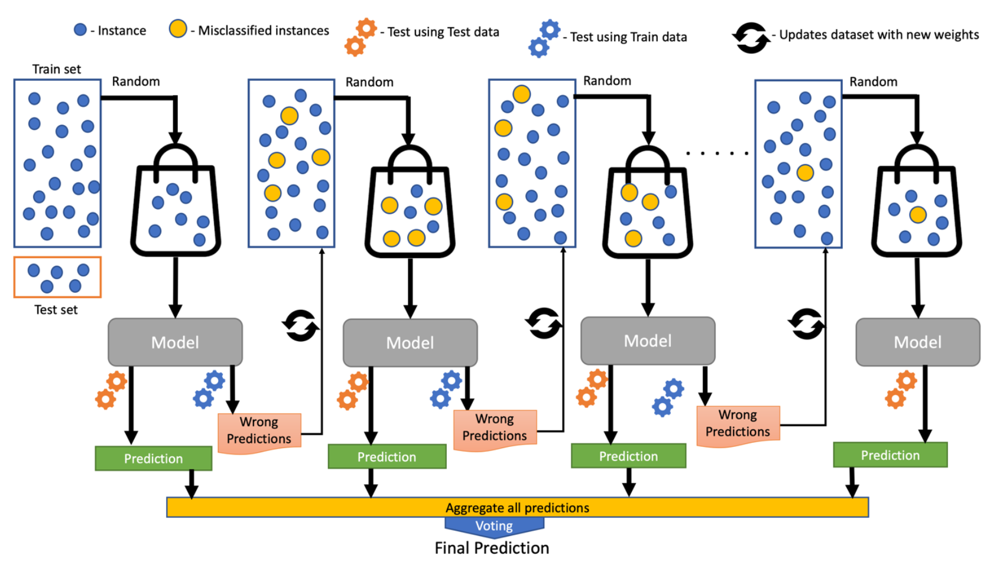

Slide 31
Algorithm | Testing Accuracy-Hr | Recall-Hr | MCC-Hr
Logistic Regression | 0.7024 | 0.7109 | 0.4049
Random Forest Classifier | 0.671 | 0.6784 | 0.3421
AdaBoost Classifier | 0.6811 | 0.6943 | 0.3629
Bernoulli Naive Bayes | 0.507 | 0.507 | 0
Multinomial Naive Bayes | 0.6958 | 0.6944 | 0.3914
SVC | 0.61 | 0.7915 | 0.2851
XGBoost | 0.7079 | 0.7181 | 0.4161
Highest Accuracy & MCC is achieved by XGBoost

Slide 32
Machine Learning Approach

Slide 33
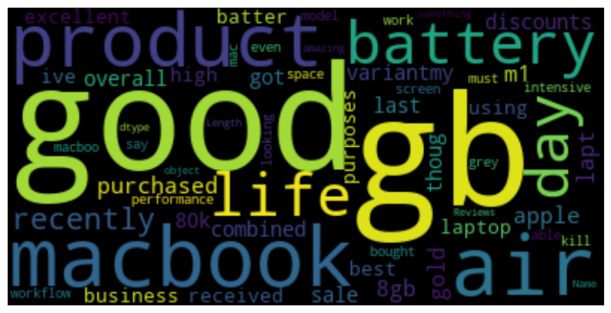
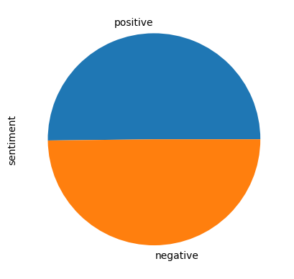
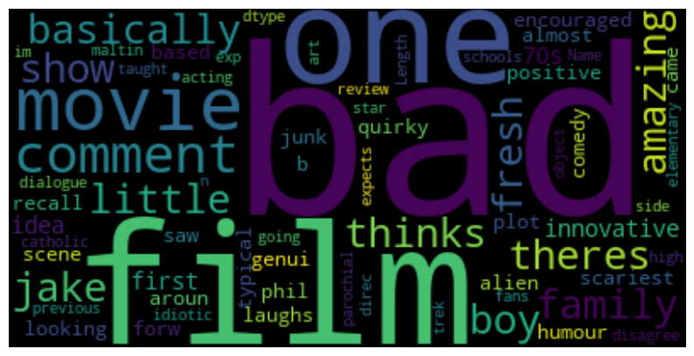
Exploratory Data Analysis
Positive Sentiment
Negative Sentiment

Slide 34
Count Vectorization
Count vectorization is a technique used to represent text data numerically in a format that machine learning algorithms can understand. It is a fundamental step in natural language processing (NLP) tasks.In count vectorization, each document is represented as a vector, and the elements of the vector correspond to the count or frequency of each word or term in the document
Vocabulary Creation : A vocabulary is created by compiling a list of unique tokens (words or terms) present in the entire corpus or collection of documents. Each token becomes a feature or dimension in the resulting vector space representation.
Count Calculation: For each document, the count vectorization process counts the occurrences of each token in that document and assigns the counts to the corresponding feature in the vector representation. The count can be either the absolute occurrence count or the term frequency (normalized by document length).
The resulting count matrix is typically a sparse matrix, as most documents will only contain a subset of the entire vocabulary, and many entries will be zero.

Slide 35
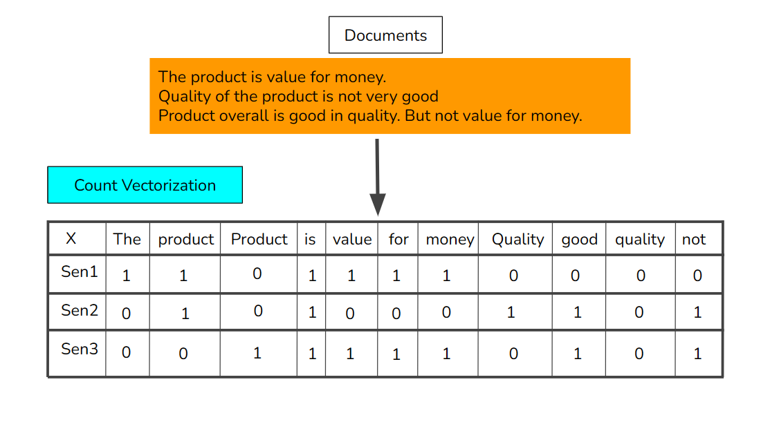
Limitations
It does not capture the order or sequence of words in the text, and it treats each word independently. There are other advanced techniques like TF-IDF (Term Frequency-Inverse Document Frequency) and word embeddings (e.g., Word2Vec, GloVe) that address these limitations and capture more semantic information from the text.

Slide 36
Algorithm | Testing Accuracy-CV | Recall-CV | MCC-CV
Logistic Regression | 0.8927 | 0.8923 | 0.7854
Random Forest Classifier | 0.8615 | 0.8697 | 0.7232
AdaBoost Classifier | 0.7924 | 0.7857 | 0.5848
Bernoulli Naive Bayes | 0.8558 | 0.8823 | 0.7133
Multinomial Naive Bayes | 0.8572 | 0.8762 | 0.7153
SVC | 0.8697 | 0.8736 | 0.7394
XGBoost | 0.8658 | 0.8543 | 0.7319
Highest Accuracy & MCC is achieved by Logistic Regression

Slide 37
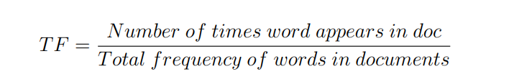
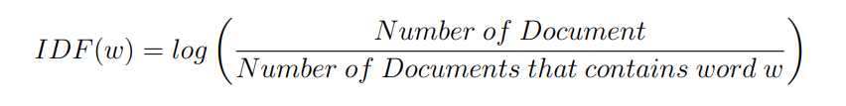
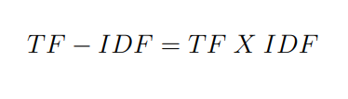
TF-IDF
Term Frequency-Inverse Document Frequency is a popular technique in NLP used to represent and evaluate the importance of words or terms in a document corpus. It measures the relevance of a term to a specific document in the context of the entire corpus. It is a numerical statistic that quantifies the significance of a word or term within a document corpus. It combines two key metrics: TF and IDF. TF measures how frequently a term appears in a document, while IDF determines the rarity of the term across the entire corpus.

Slide 38
Algorithm | Testing Accuracy-TFIDF | Recall-TFIDF | MCC-TFIDF
Logistic Regression | 0.9009 | 0.8949 | 0.8018
Random Forest Classifier | 0.8425 | 0.8327 | 0.6852
AdaBoost Classifier | 0.7722 | 0.7659 | 0.5444
Bernoulli Naive Bayes | 0.8545 | 0.8826 | 0.7109
Multinomial Naive Bayes | 0.8593 | 0.9007 | 0.7226
SVC | 0.9007 | 0.8989 | 0.8013
XGBoost | 0.8637 | 0.8517 | 0.7277
Highest Accuracy & MCC is achieved by Logistic Regression

Slide 39
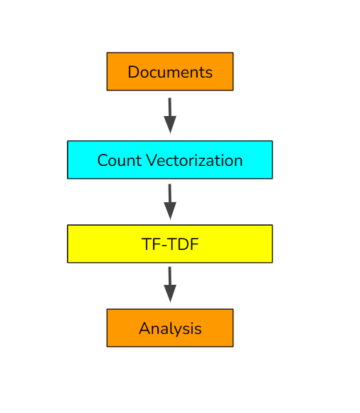
Hybrid CV- TF-IDF
In this method we used the combination of count vectorization and TF-IDF which involves two sequential steps to convert text data into numerical representations:
we first convert the text documents into count vectors, where each vector represents the frequency of each token within a document. This step captures the local information within each document.
Then, the count vectors are transformed into TF-IDF representations, which take into account both the local importance of tokens within each document (TF) and the global significance of tokens across the entire collection (IDF). This step helps to emphasize rare and informative terms while dampening the impact of common terms.

Slide 40
Algorithm | Testing Accuracy-CV-TFIDF | Recall-CV-TFIDF | MCC-CV-TFIDF
Logistic Regression | 0.9053 | 0.8964 | 0.8108
Random Forest Classifier | 0.8425 | 0.8327 | 0.6852
AdaBoost Classifier | 0.7795 | 0.7771 | 0.559
Bernoulli Naive Bayes | 0.8545 | 0.8826 | 0.7109
Multinomial Naive Bayes | 0.8593 | 0.9007 | 0.7226
SVC | 0.9007 | 0.8989 | 0.8013
XGBoost | 0.8637 | 0.8517 | 0.7277
Highest Accuracy & MCC is achieved by Logistic Regression

Slide 41
Stacking Classifiers
Stacking Classifiers, is an ensemble learning technique that combines multiple individual classifiers to improve predictive performance. It leverages the idea that different classifiers may excel in different regions of the feature space or on different subsets of the data.
The basic idea behind stacking is to train several diverse base classifiers on the same dataset. Instead of making predictions individually, the outputs of these base classifiers serve as inputs to a higher-level meta-classifier. The meta-classifier learns to combine the predictions of the base classifiers and produce the final prediction.
Stacking typically involves two or more layers:
Base Classifiers: Multiple base classifiers are trained on the same training set independently. Each base classifier may utilize different algorithms or have different hyperparameter settings.
Meta-Classifier: A meta-classifier is trained on the predictions of the base classifiers. The meta-classifier takes these predictions as input features and learns to make the final prediction.

Slide 42
Base- Learners
Random Forest
Meta - Learner
AdaBoost Classifier
SVC
Naive Bayes Classifiers
SVC
XGBoost
Logistic Regression

Slide 43
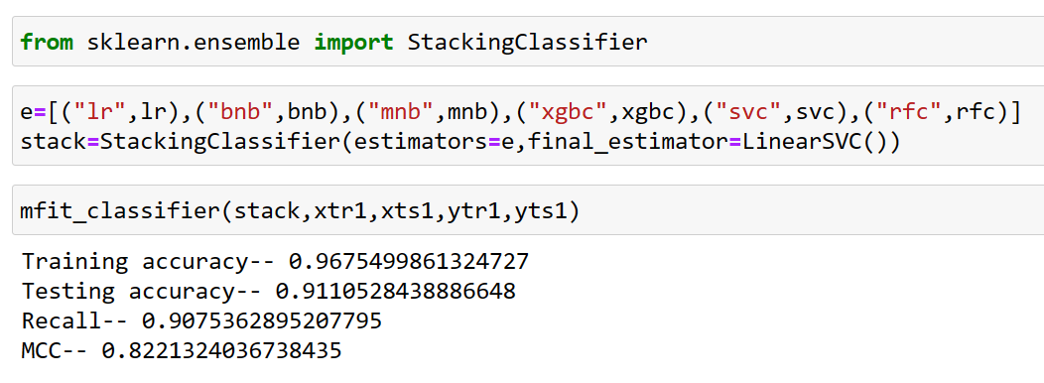
Stacking classifiers gave us the highest testing accuracy of 91.10% and highest MCC score of 82.21%

Slide 44
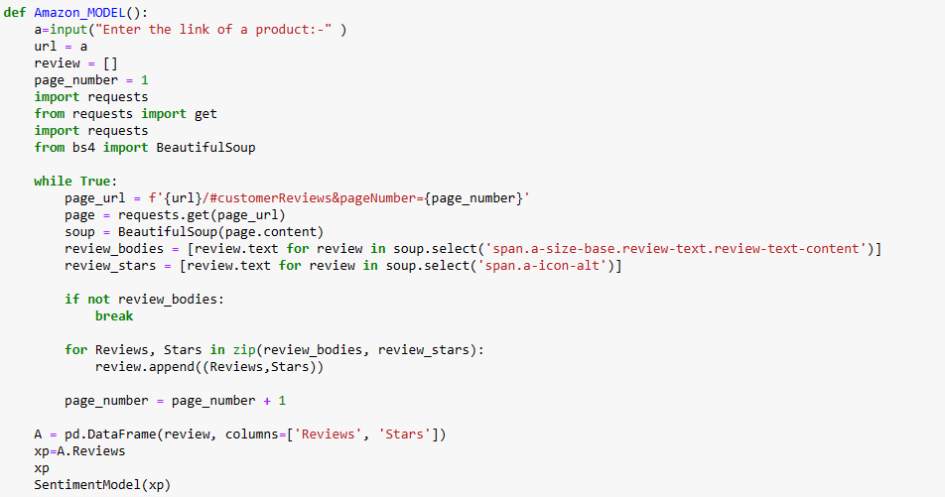
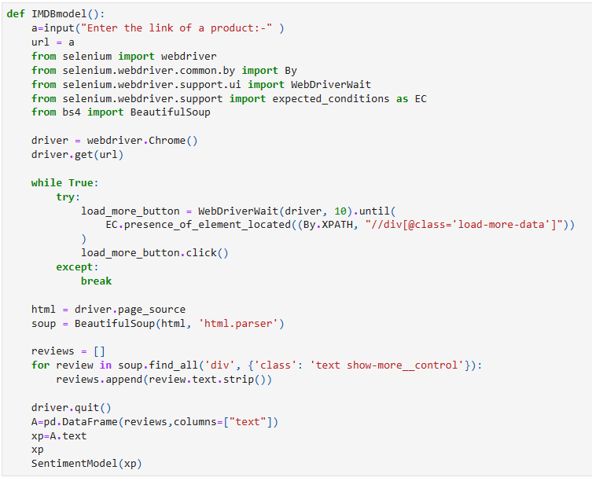
Amazon Model
IMDB Model

Slide 45
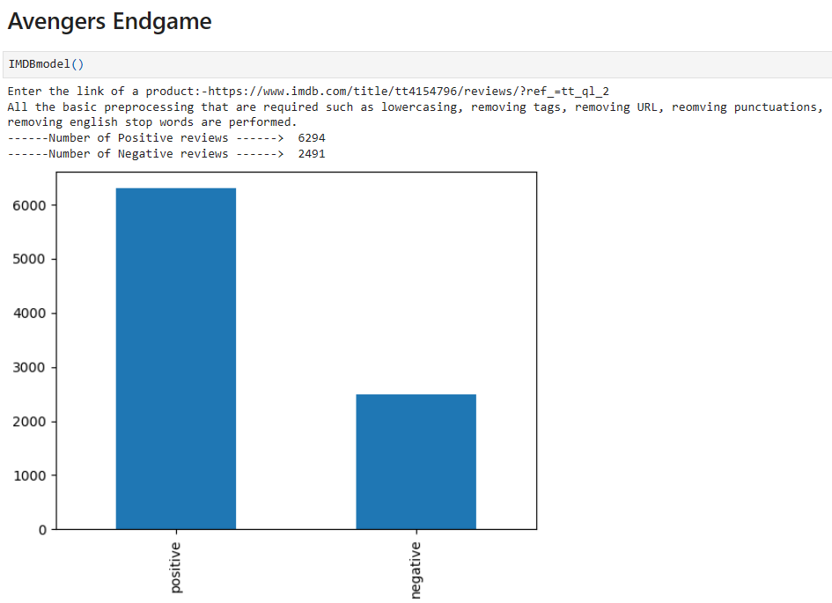
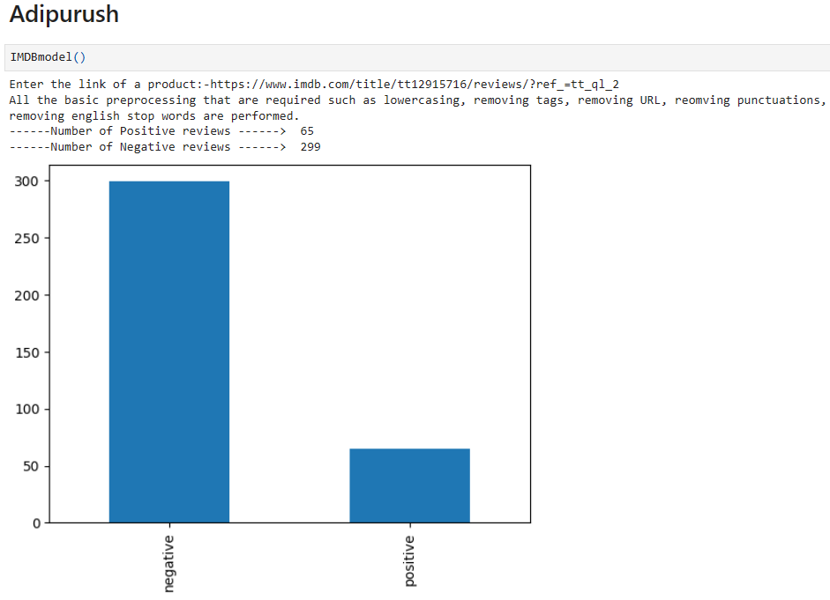
Real Time Analysis
IMDB Model

Slide 46
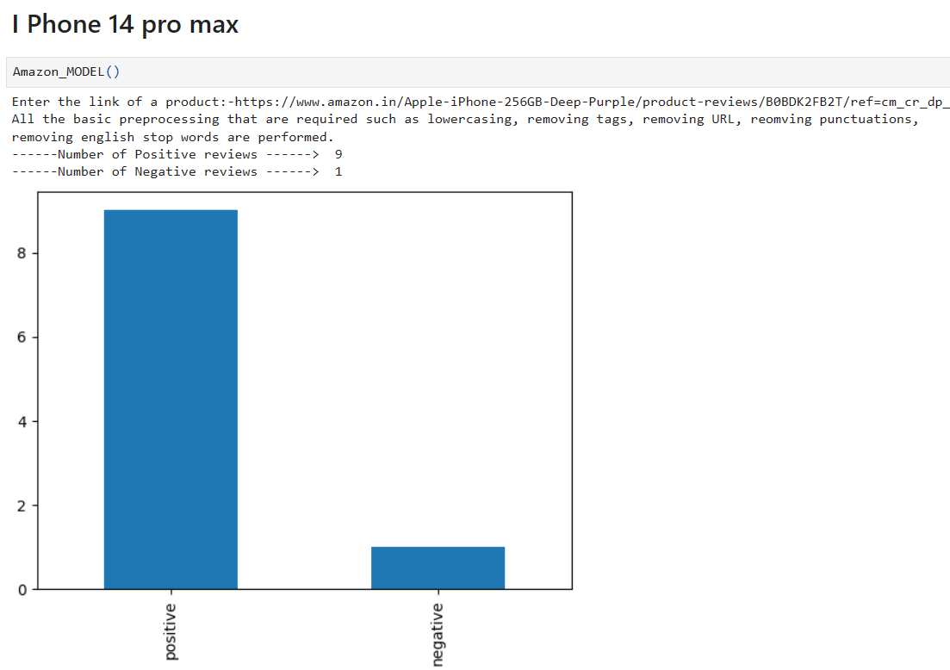
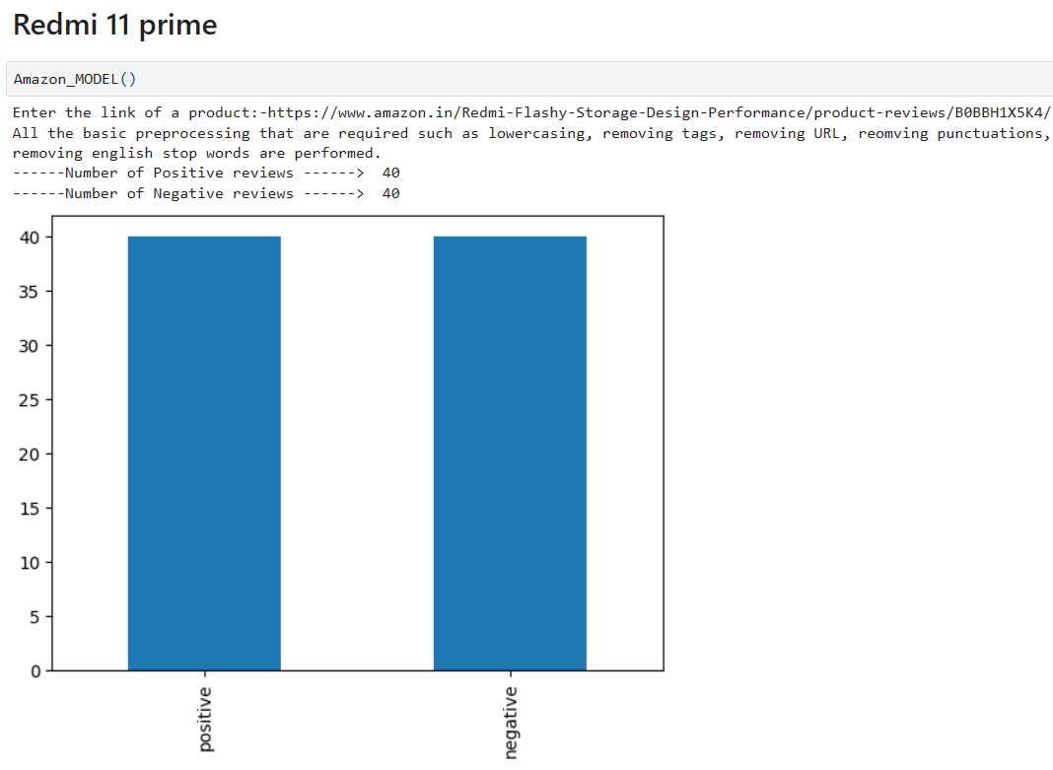
Amazon Model

Slide 47


Slide 48
THANK YOU

